Slide 1
Deliverable 1
By Joshua Indig, Tristan Giannopoulos, Farhan Haque, Kevin-Yichen Li

Slide 2
Idea #1 – Electrical Circuit (Joshua)
Concept: A program that allows to construct an electrical circuit with electrical components (batteries, resistors, light bulbs) and wires. The program would provide users a way to visualize electrical components of everyday objects or to create their own electrical device.
Physical concepts:
- Ohm's law
AC and DC
Energy

Slide 3
Idea #2 – Ray diagram simulation (Farhan)
Concept: The ray diagram simulation allows the student to visualize how a ray can be reflected through a mirror. This tool can be helpful to students who are finding this concept difficult to imagine and to draw.
Concept aspects:
Includes animation of ray reflecting through the mirrors.
Allows user to change variables like focal length, object distance and object height.
Users can chose between converging and diverging lenses.
Users can also add multiple lenses to visualize the ray.

Slide 4
Idea #3 – 2 Body Simulation (Tristan)
Concept:
A simulation of how two large bodies of mass interact with each other such as a moon orbiting a planet or a planet orbiting the sun. Allowing the user to adjust the mass of each body and the radius of the orbit.
Concept aspects:
Includes an animation of the small body of mass orbiting the large body of mass
Adjustable value inputs for mass, orbital radius and gravity constant
Utilization of Newton's universal law of gravity
Utilization of Kepler's first law

Slide 5
Idea #4 – Simple pendulum simulator by Kevin
This program allows for the simulation of the motion of an object attached to a string, which undergoes simple harmonic motion. The physical concepts involved include oscillations, kinetic and potential energy in SHM, and the dynamics of physics. The program aims to help students visualize the physical phenomenon, enabling them to develop a deeper understanding of this concept. Through interactive user inputs via the GUI, users can observe changes in the motion based on factors such as the initial angle, mass, string length, and more.

Slide 6
Idea chosen – Ray diagram simulation

Slide 7
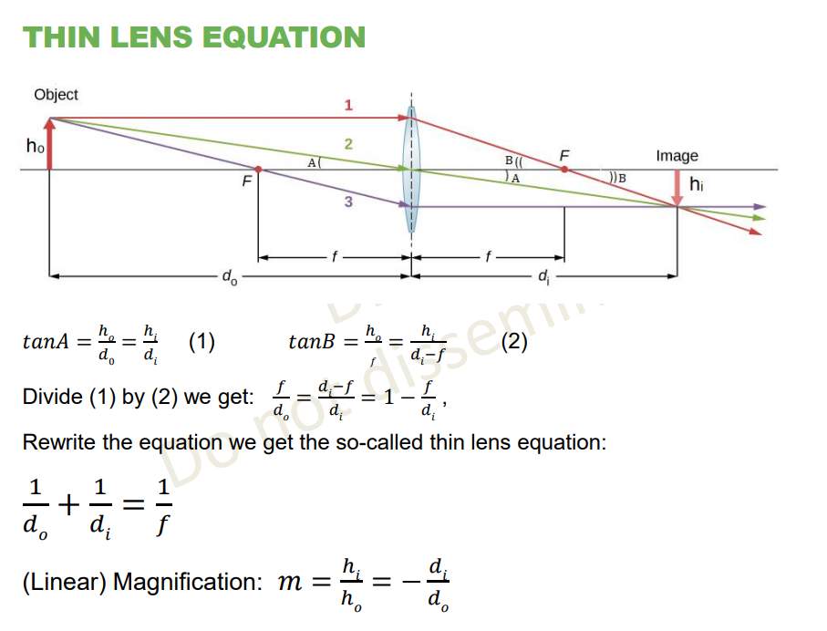
Concept
Main physical concepts involved are geometrical optics equations, image formation, types of lenses and microscope.

Slide 8
Concept Aspects
The ray diagram simulation allows the student to visualize how rays of light can be go through lenses by three principle rays and how rays are reflected by a mirror. This tool can be helpful to students who are finding this concept difficult to imagine and to draw. Furthermore, the program allows to simulate multiple lenses system
Possible user-input parameters: type of lenses/mirrors, magnification, focal length, number of lenses/mirrors, etc.
Extra: eyesight problems (astigmatism, myopia, etc.) If time allows.

Slide 9
Typical Input
Users can decide between many variables such as the placement of the object, its height and the focal length. They can also choose between converging and diverging lenses which includes their individual magnification. The program will also include the choice of creating a multiple lens system. They will also have the choice between what kind of mirrors they want to use such as concave, convex and straight. Expected features are to come.

Slide 10
Expected output
According to user inputs, formulas would be applied to calculate certain physical quantities, so that the correct position and height of the object and the image would be displayed. Three principle rays would be displayed to show the process of formation of the image.

Slide 11
Feasibility
JavaFX elements: layout panes, event handler, event listener, buttons, text field, binding, SceneBuilder, fonts, background color, language, audio, animation, switch scenes, spinners, controls, etc.
Basic timeline: design functions to calculate the required variables for display, displaying the variables in an intuitive way and making the design look more user-friendly

Slide 12
Individual Part - Joshua
Backend of lenses
Thin lens equation
About us, help, exit in menu bar

Slide 13
Individual Part - Kevin
Some UI components of the lenses scene.
General Setting
Physical formulas implementation (partial)
Event handlers that relate the inputs to the backend formulas
Some UI of the main page

Slide 14
Individual Part - Tristan
Front end visualization of mirrors
Displaying the values calculated in a user friendly manner
Animation settings
Main page

Slide 15
Individual Part - Farhan
Backend visualization of mirrors
Partial physical formulas implementation
Theme settings
Partial UI components

